Slide 1

Developing A Chatbot To Answer Wikipedia Queries
Final Year Project
Alex Turner

Slide 2
Overview
Chatbot application for answering factoid questions about people and countries
Who is Alan Turing?
What is he known for?
Where was Barack Obama born?
What is the capital of Honduras?

Slide 3
Objectives
Discuss and explore current and future uses of chatbots in research and industry environments.
Gather user requirements for a chatbot knowledge base implementation within the scope of the project.
Implement a novel chatbot application to resolve user queries and provide worthwhile responses automatically.
Test the implementation against the requirements set out by the users.
Evaluate the success of the implementation of the system with regards to the scope and requirements of the project, and provide suggestions for future development.

Slide 4

Technologies
Java
Spring Boot
Artificial Mark-up Language (AIML)
SPARQL Query Language
DBPedia

Slide 5
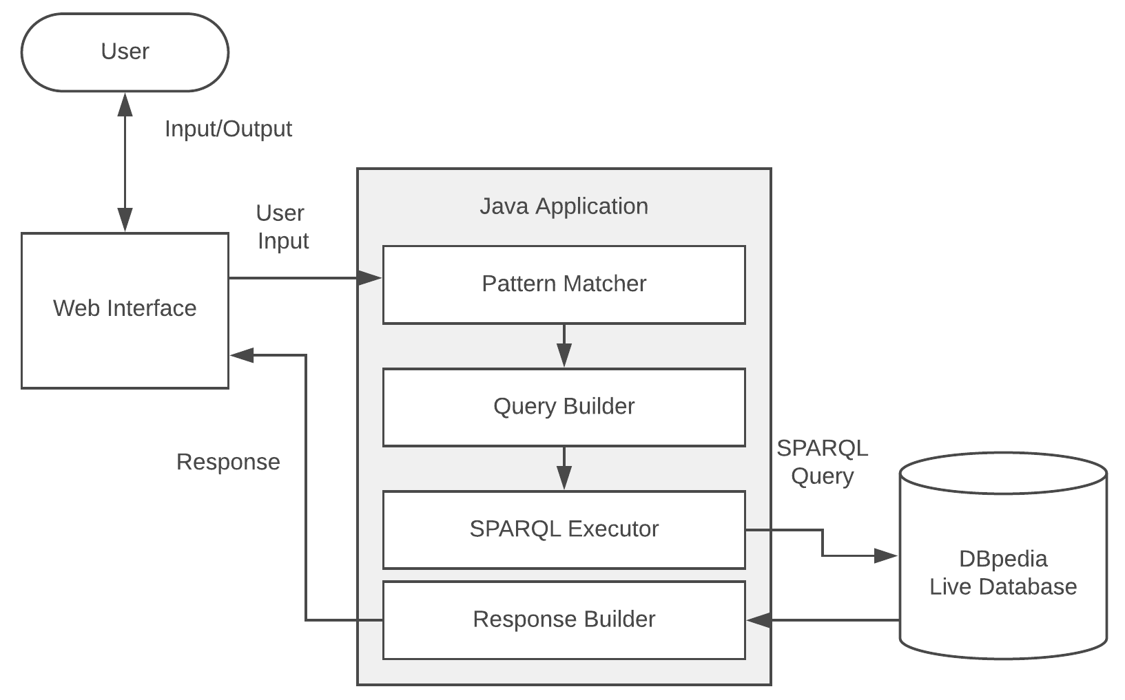
Architecture

Slide 6
Future Work
Improved search functionality
More robust filtering
Extension to more datasets
User feedback system

Slide 7
Conclusion
Successful project, the implementation was effective and met the requirements
Pattern-based system was very manual
A user feedback loop would be useful to provide more relevant results

